Slide 1
Evidence Acquisition
Chapter 3

Slide 2
Physical Interception
Cables
Copper
Optical
Intercepting traffic in cables
Inline network taps
Vampire taps
Induction coils
Fiber optic taps

Slide 3
Physical Interception (con’t)
Radio frequency
Hubs
Switches
Obtaining traffic from switches
MAC flooding (attacks the switch’s CAM table directly, causing the switch to send traffic out on all ports, and not just specific ones)
ARP spoofing (attacks the ARP tables of the hosts on the LAN)

Slide 4
Traffic Acquisition Software
Libpcap and WinPcap
Berkeley Packet Filter (BPF) language
BPF Primitives
Filtering packets by byte value
Filtering packets by bit value
Tcpdump
Fidelity
Filtering packets with tcpdump
The Evil Bit (RFC 791)
Wireshark
Tshark
dumpcap

Slide 5
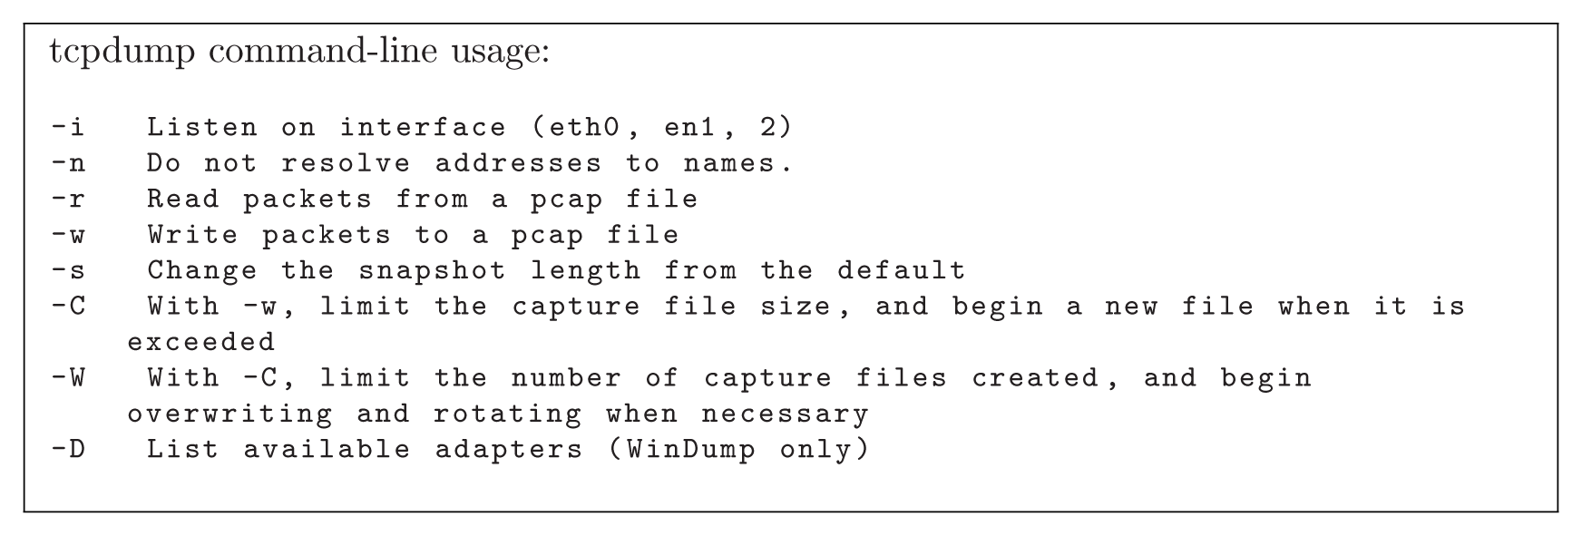
From Network Forensics, by Sherri Davidoff and Jonathan Ham (ISBN: 978-0-13-256471-7) Copyright © 2012 Pearson Education, Inc. All rights reserved.
Figure 3.1 Handy tcpdump command-line options. See the tcpdump manual for more details.

Slide 6
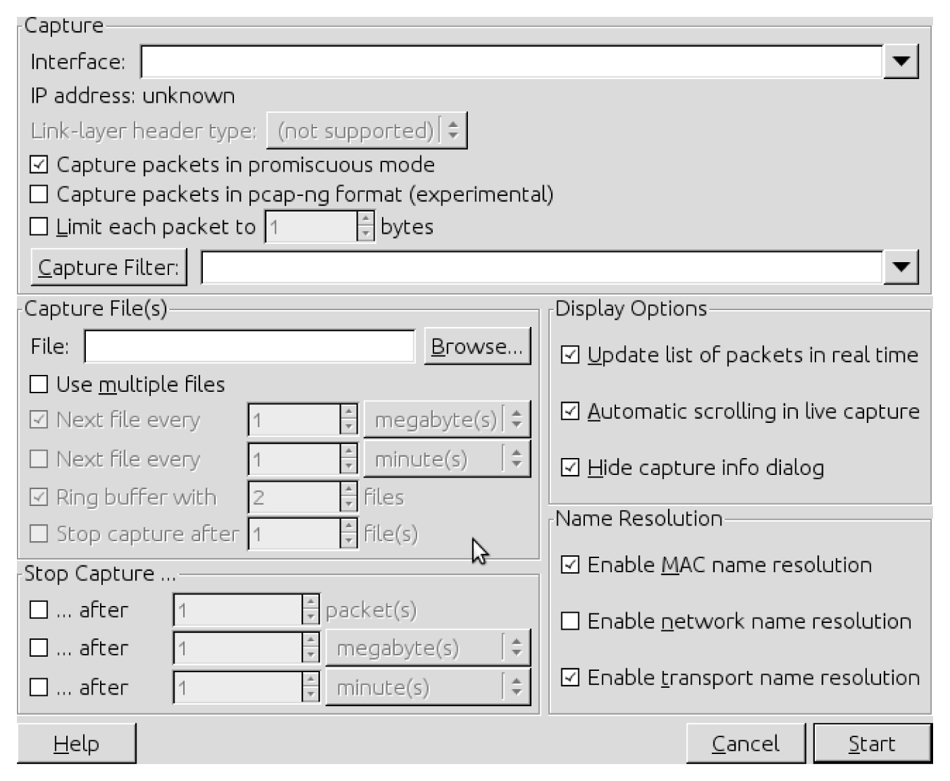
From Network Forensics, by Sherri Davidoff and Jonathan Ham (ISBN: 978-0-13-256471-7) Copyright © 2012 Pearson Education, Inc. All rights reserved.
Figure 3.2 Wireshark’s “Capture Options” screen (Wireshark version 1.2.11).

Slide 7
Active Acquisition
Common interfaces
Console
Secure shell (SSH)
Secure copy (SCP) and SFTP
Telnet (yes, Telnet)
Simple Network Management Protocol (SNMP)
Trivial FTP
Web and proprietary interfaces

Slide 8
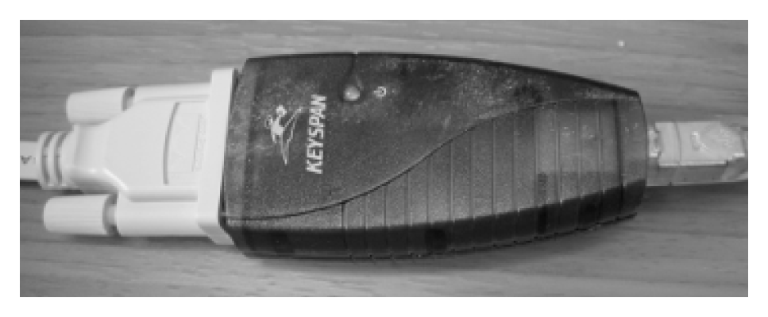
From Network Forensics, by Sherri Davidoff and Jonathan Ham (ISBN: 978-0-13-256471-7) Copyright © 2012 Pearson Education, Inc. All rights reserved.
Figure 3.3 A Keyspan serial-to-USB adapter, which can be used to connect a modern laptop or desktop to the serial console of a network device.

Slide 9
Active Acquisition (con’t)
Inspection without access
Port scanning
Vulnerability scanning
Strategy
Refrain from rebooting or powering down the device
Connect via the console rather than over the network
Record the system time
Collect evidence according to level of volatility
Record your investigative activities

